Slide 1
CS 1331 - Day 1
Introduction to Object Oriented Programming

Slide 2
Who am I?
Suzy Watson-Phillips
Lecturer, DCI
Room 258, College of Computing Building (Virtual this semester)
suzy.watson-phillips@cc.gatech.edu

Slide 3
Family photos & About Me…

Slide 4
Who are your TAs?
TA lab office hours will be posted this week!
Office hours will be 100% virtual and you will provide a URL to a meeting/room you have setup through a form. More information to come, be on the lookout for an announcement.

Slide 5
What is this course about?

Slide 6
From Catalog...
Introduction to the techniques and methods of object-oriented programming such as encapsulation, inheritance, and polymorphism. Emphasis on software development and individual programming skills.

Slide 7
Okay, but what are we actually going to learn?
Object oriented programming using the Java programing language.
Here is the living schedule:
https://gtvault.sharepoint.com/:w:/s/CS1331TAs-Fall2020/ESKsnT4-Y2BEk0xVw_-O2ZQBN6MgBhLRE1iRHF9ZAdtcCg?e=xKcbly

Slide 8
Policies, Assignments, Grading... Syllabus Review

Slide 9
Canvas Homepage

Slide 10
Tools to be used
Canvas!
Homepage
Quizzes
Assignments
Modules
Files
GradeScope
HonorLock
Java … later on an IDE to go with it

Slide 11
How do I ...
Get TA help during help desk office hours?
Create a BlueJeans meeting?
Access Piazza?
Turn in homework?

Slide 12
Practice using Canvas Quizzes
Take the survey after lecture!

Slide 13
Why Object Orient Programming?

Slide 14
OOP models the real world
Object oriented programming is a programming methodology that models the real world.
Class are the model, blueprint or template from which specific objects are made. An object oriented program is a collection of objects that interact to model a system.
Each class has state (attributes) and behaviors (methods)
Encapsulation refers to each object managingg its own data. Inheritance refers to class hierarchy. These are key OOP principles that we will come back to later in the semester.

Slide 15
Programming Language Levels

Slide 16
Interpreted vs. Compiled
Interpreted:
Python
Interweave translation and execution
Compiled:
C, C++, Go, Swift
High level source
Assembly
Machine code (binary)

Slide 17
Let’s talk about Java

Slide 18
Java is...
“Java is a full-featured, general-purpose programming language that can be used to develop robust mission-critical applications”
“Java syntax is defined in the Java language specification, and the Java library is defined in the Java application program interface (API). The JDK is the software for compiling and running Java programs.” -Textbook (Y. Daniel Liang)
“Java is a general-purpose programming language that is class-based, object-oriented[15] (although not a pure object-oriented language, as it contains primitive types[16]), and designed to have as few implementation dependencies as possible.” -https://en.wikipedia.org/wiki/Java_(programming_language)

Slide 19
Is Java Interpreted or Compiled?
… It's a hybrid...

Slide 20
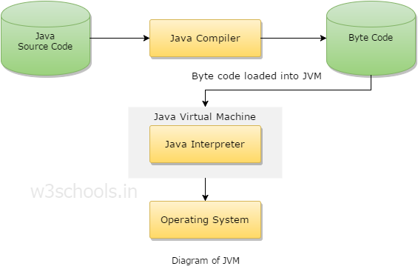

Slide 21
Syntax vs. Semantics
Syntax is what is legal in a language (i.e. the grammar and structure).
Semantic is how the statements get interpreted, what the meaning of the symbols is.

Slide 22
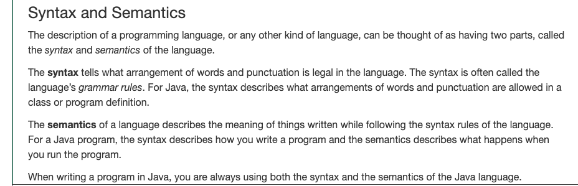
Syntax vs. Semantics (more detail)
Absolute Java, Walter Savitch, 6th edition

Slide 23
What’s coming up...
PE 0: get java installed and complete the assignment
Recitation tomorrow!
PE: 1 will come out Friday
No participation activities this week other than the first day survey.

Slide 24
Example program
Write program in a text editor
Save file
Compile the file into bytecode
Run program using the JVM

Slide 25
Terminology
JDK: Java Development Kit; compiler + interpreter
Syntax: the grammar or rules; how do I write a valid statement
Semantics: the meaning of the statement; what does a for loop mean
Encapsulation: Each object manages its own data
Inheritance: Classes form a hierarchy
IDE: Integrated Development Environment (we will come back to this)
Source Code: the program you write; collection of statements in a file
Byte Code: result of compiling source code into portable code for the interpreter (java byte code)
(Java) Compiler: converts source code into byte code

